Slide 1
BODY FLUIDS
DR K.R. RESHMY M.D. (Hom.)
Associate Professor
Dept. of Physiology and Biochemistry

Slide 2
Body Fluids
Water content in body is divided into 2 compartments:
1. Extracellular fluid (ECF): (internal environment or the milieu intérieur)
- fluid outside the cells.
≈ 1/3 volume of fluids in body (≈ 33% of total body water).
- contains ions & nutrients needed for cellular life.
2. Intracellular fluid (ICF):
- fluid inside the cells.
≈ 2/3 volume of fluids in body (≈ 67% of total body water).

Slide 3
Body Fluids
Intracellular
All fluids inside cells of body
About 40% of total body weight
Extracellular
All fluids outside cells
About 20% of total body weight
Subcompartments
Interstitial fluid and plasma; lymph, CSF, synovial fluid

Slide 4
Internal Environment and Homeostasis
Total body water = 60 % BW
Extracellular fluid
Blood Plasma
1/5
1/3
Interstitial fluid
4/5
Intracellular fluid
2/3
= 40 % BW

Slide 5
Internal environment
Intracellular
fluid
Plasma
Interstitial fluid
Extracellular fluid directly baths body cells
Internal environment = Extracellular fluid

Slide 6
Extracellular fluids
Intracellular
fluid
2. Plasma
1. Interstitial fluid
3. Fluid of special compartments: pericardial fluid, pleural fluid, cerebrospinal fluid

Slide 7
Functions of body fluids
1. In homeostasis
2. In transport mechanism
3. In metabolic reactions
4. In maintaining the normal texture of tissues
5. In temperature regulation

Slide 8
Fluid Compartments ≈ 60% of body weight
Extracellular fluid
(≈ 1/3)
33% of TBW
20% of body wt
Intracellular fluid
(≈ 2/3)
67% of TBW
40% of body wt
Plasma
25% of ECF
5% of body wt
Interstitial fluid
75% of ECF
15% of body wt
Transcellular fluid
CSF
Intraocular
Pleural
Peritoneal
Pericardial
Synovial
Digestive secretions

Slide 9
Example: How to calculate total body water (TBW)?
Q. Calculate TBW for a 70 kg man.
TBW = 60% of body weight
TBW = 60% X 70 = 42 L of water

Slide 10
Differences between ECF & ICF
ECF
Anions: Cl⁻ (108) HCO₃⁻ (24) | Cations: Na⁺ (142mmol/L) K⁺ (4.2) Mg²⁺ (0.8)
Nutrients: O₂, glucose, fatty acids, & amino acids.
Wastes: CO₂, Urea, uric acid, excess water, & ions.
ICF
Anions: Cl⁻ (4) HCO₃⁻ (10) Phosphate ions | Cations: Na⁺ (14) K⁺ (140) Mg²⁺ (20)
Nutrients: High concentrations of proteins.

Slide 11
Factors affecting body fluids
Water intake & output
Age:
- infant: 73%
- elderly: 45%
Sex:
- adult male: 60%
- adult female: 40-50%
Obesity
Climate
Habits
Level of physical activity

Slide 12
Body composition
In average young adult male:
% of body weight | Body composition
18% | Protein, & related substances
15% | Fat
7% | Mineral
60% | Water

Slide 13
Daily intake & output of water (ml/day)
Prolonged, heavy exercise | Normal
? 200 | 2100 200 | Intake: Fluids ingested (Drinking/in food) From metabolism
? | 2300 | Total intake
350 650 5000 100 500 | 350 350 100 100 1400 | Output: Insensible – skin Insensible – lungs Sweat Feces Urine
6600 | 2300 | Total output
In steady state, water intake = water loss

Slide 14
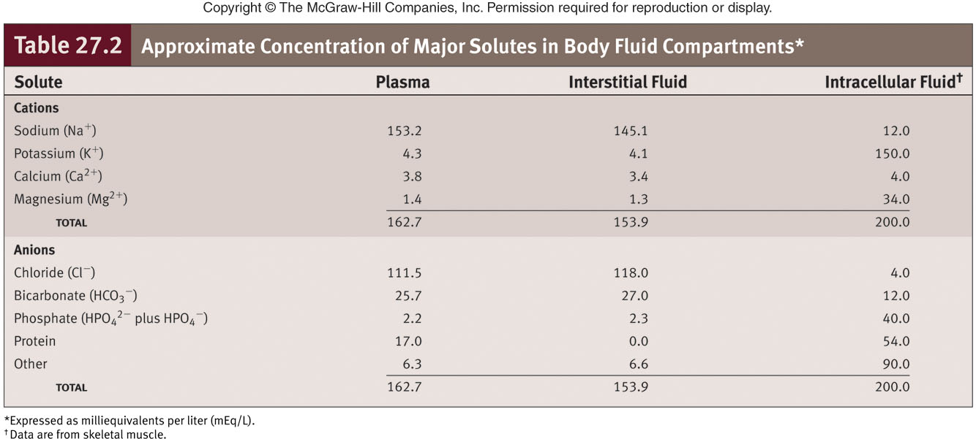
Body Fluid Compartments

Slide 15
Water Content Regulation
Content regulated so total volume of water in body remains constant
Kidneys primary regulator of water excretion
Regulation processes
Osmosis
Osmolality
Baroreceptors
Learned behavior
Sources of water
Ingestion
Cellular metabolism
Routes of water loss
Urine
Evaporation
Perspiration
Respiratory passages
Feces

Slide 16
Concentration of body fluids
Expressed in terms of 3 ways
Osmolality
Osmolarity
tonicity

Slide 17
osmolality
-is a measurement of the amount of osmotically effective solute per 1000grams of solvent(osm)
It is the molar equivalent of the no. of molecular particles in a litre of water.

Slide 18
calculation
Serum osmolality = 2 x Na⁺ (meq/L) +
BUN(mg/dl) + glucose(mg/dl)
2.8 18
Normal serum osmolality is 280 to 295 mOsm/L

Slide 19
Osmolarity
The number of osmotically active particles in a litre of solution .

Slide 20
tonicity
Expressing effective osmolality
Large molecules like Na and glucose which cross the cell membrane slowly influences the movement of water from one compartment to another.
These molecules are responsible for effective osmolality.

Slide 21
Isotonic (0.9%Nacl sol and 5% glucose sol. Fluid which have same effective osmolality as body fluids
Hypertonic(2% Nacl sol)
Hypotonic(0.3% Nacl sol)
Osmotic equi. Is maintained between inside and outside of the cell
Exosmosis---shrinkage of the cell
Endosmosis---swelling and rupture of the cell (hemolysis)

Slide 22
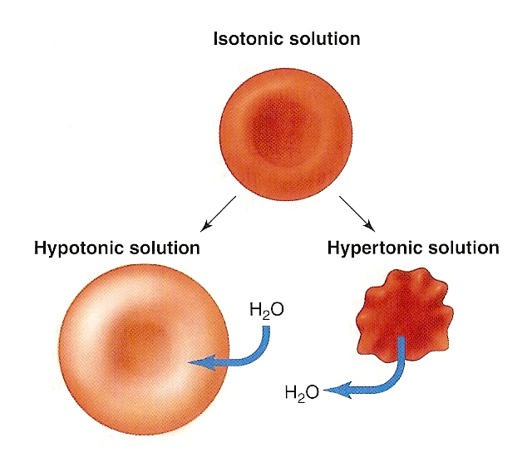
Red blood cells in isotonic, hypotonic, & hypertonic solutions. In each case, the external solution has an equal, lower, or higher osmotic pressure, respectively, than the intracellular fluid, As a result, water moves by osmosis into the red blood cells placed in hypotonic solutins, causing them to swell and even to burst. Similarly, water moves out of red blood cells placed in a hypertonic solution, causing them to shrink & become crenated.

Slide 23
Extracellular Fluid Osmolality
Osmolality
Adding or removing water from a solution changes this
Increased osmolality
Triggers thirst and ADH secretion
Decreased osmolality
Inhibits thirst and ADH secretion

Slide 24
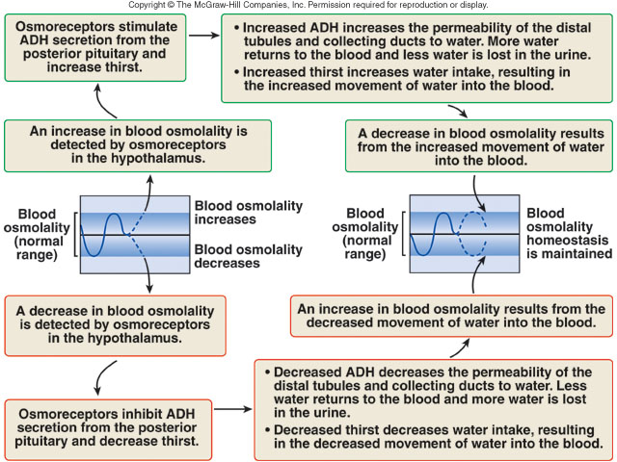
Hormonal Regulation of Blood Osmolality

Slide 25
Regulation of ECF Volume
Increased ECF results in
Decreased aldosterone secretion
Increased ANH secretion
Decreased ADH secretion
Decreased sympathetic stimulation
Decreased ECF results in
Increased aldosterone secretion
Decreased ANH secretion
Increased ADH secretion
Increased sympathetic stimulation
Mechanisms
Neural
Renin-angiotensin-aldosterone
Atrial natriuretic hormone (ANH)
Antidiuretic hormone (ADH)

Slide 26
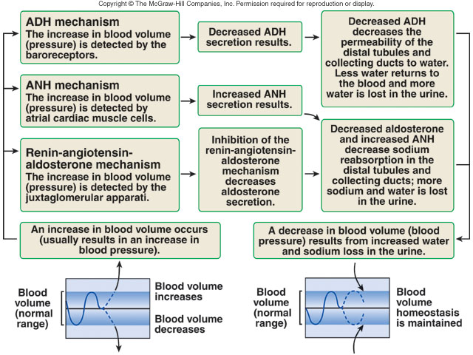
Hormonal Regulation of Blood Volume

Slide 27
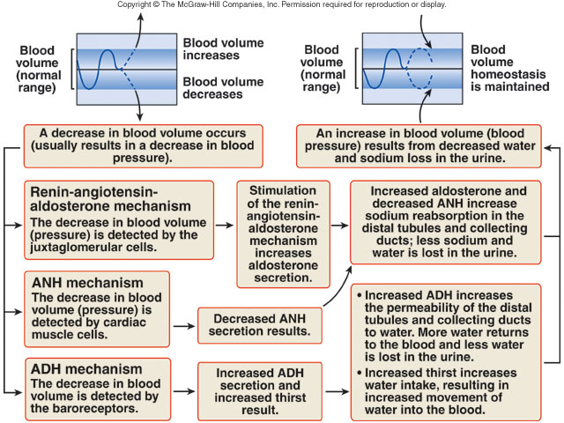
Hormonal Regulation of Blood Volume

Slide 28
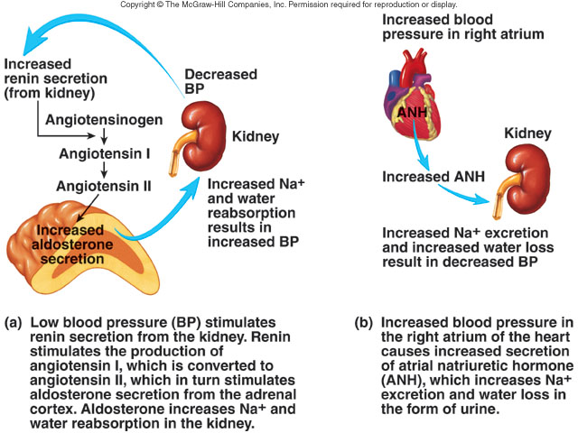
Regulation of ECF Volume

Slide 29
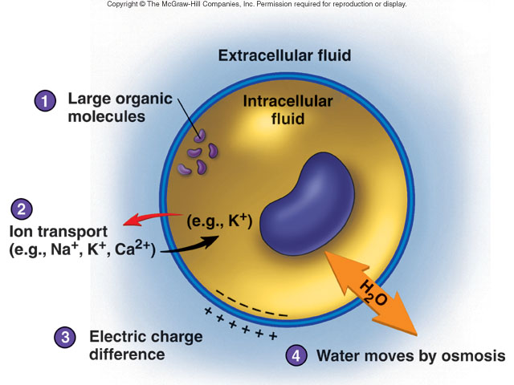
Regulation of ICF and ECF

Slide 30
Regulation of Electrolytes in ECF
Na⁺ Ions
Dominant ECF cations
Responsible for 90-95% of osmotic pressure
Regulation of Na⁺ ions
Kidneys major route of excretion
Small quantities lost in sweat
Terms
Hypernatremia
Hyponatremia
Electrolytes
Molecules or ions with an electrical charge
Water ingestion adds electrolytes to body
Kidneys, liver, skin, lungs remove from body
Concentration changes only when growing, gaining or losing weight

Slide 31
Control of body fluids
Thirst
Sweating
Renal control (aldosterone)
Neuronal (osmoreceptors, baroreceptors)

Slide 32
Dehydration
Loss of water from the body,
e.g. vomiting, diarrhea, sweating, & polyuria.
Leads to ↓ in both ECF & ICF volumes.
↑ osmolarity in both ECF & ICF.
General signs:
- Dry tongue
- loss of skin elasticity
- soft eyeballs (due to lowering of intraocular tension)
- ↓ blood pressure (if ≥ 4-6L loss)
- ↑ Hb, & ↑ Hct (packed cell volume)
Treated w fluid replacement (orally, or IV).

